Slide 1
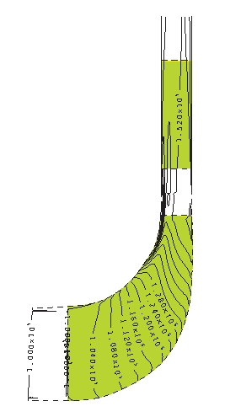
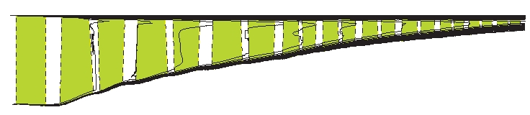
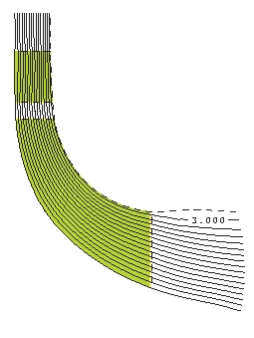
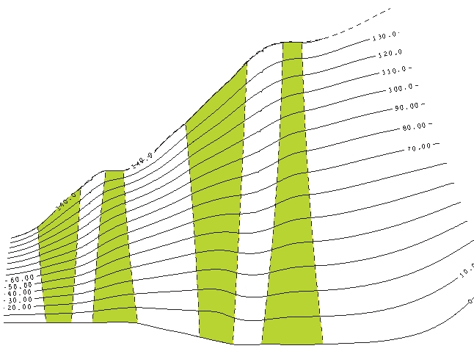
MULTALL – AN OPEN-SOURCE, CFD BASED, TURBOMACHINERY DESIGN SYSTEM
ASME GT2017-63993
John Denton
Retired from the Whittle Lab, Cambridge University, UK.
The objective of this paper is to present a turbomachinery aerodynamic design system that is relatively simple to use and is freely available to anyone.

Slide 2
Turbomachinery design systems are usually the property of large companies and are very complex.
The author has, over many years developed a system based on his widely-used 3D CFD code MULTALL . The system is intended to be relatively simple and easy to use. The source codes are written in FORTRAN and are freely available to any user.
It is hoped that this system will be of use to smaller companies and academics who do not have access to an “in-house” design system.

Slide 3
A turbomachinery design system generally consists of the following steps:
Specify overall parameters such as mass flow rate, mean diameter, rotational speed, inlet flow conditions, exit pressure.
Perform a one-dimensional mean-line calculation to obtain the annulus shape and mid-span blade angles.
Perform a 2D axisymmetric throughflow calculation in the inverse (design) mode to obtain the variation of flow angles along the span.
Repeat the throughflow calculation in the analysis mode to predict the blade losses, machine efficiency and stream surface thickness distributions.
Perform quasi-3D (Q3D) blade-to-blade calculations at several spanwise sections on each blade row to design the blade shapes.
Perform relatively coarse grid, multistage, 3D, viscous calculations for the main flow path of the whole machine to optimise the blade stacking.
7. Perform more detailed 3D calculations to include the effects of leakage flows endwall bleeds and cavities and coolant flows. These will give the final prediction of machine overall performance.
Each of these steps is likely to be repeated several times with returns to previous steps often being necessary.

Slide 4
The author has long maintained that, given a flexible geometry generator and a fast 3D solver, it is simpler and faster to omit steps 3 to 5, and go straight from the mean line design to fairly coarse grid 3D calculations to optimise the blade shapes and stacking.
This is the basis if the present design system.
Specify overall parameters such as mass flow rate, mean diameter, rotational speed, inlet flow conditions, exit pressure.
Perform a one-dimensional mean-line calculation to obtain the annulus shape and mid-span blade angles.
Perform a 2D axisymmetric throughflow calculation in the inverse (design) mode to obtain the variation of flow angles along the span.
Repeat the throughflow calculation in the analysis mode to predict the blade losses, machine efficiency and stream surface thickness distributions.
Perform quasi-3D (Q3D) blade-to-blade calculations at several spanwise sections on each blade row to design the blade shapes.
Perform relatively coarse grid, multistage, 3D, viscous calculations for the main flow path of the whole machine to optimise the blade profiles and the blade stacking.
7. Perform more detailed 3D calculations to include the effects of leakage flows endwall bleeds and cavities and coolant flows. These will give the final prediction of machine overall performance.

Slide 5
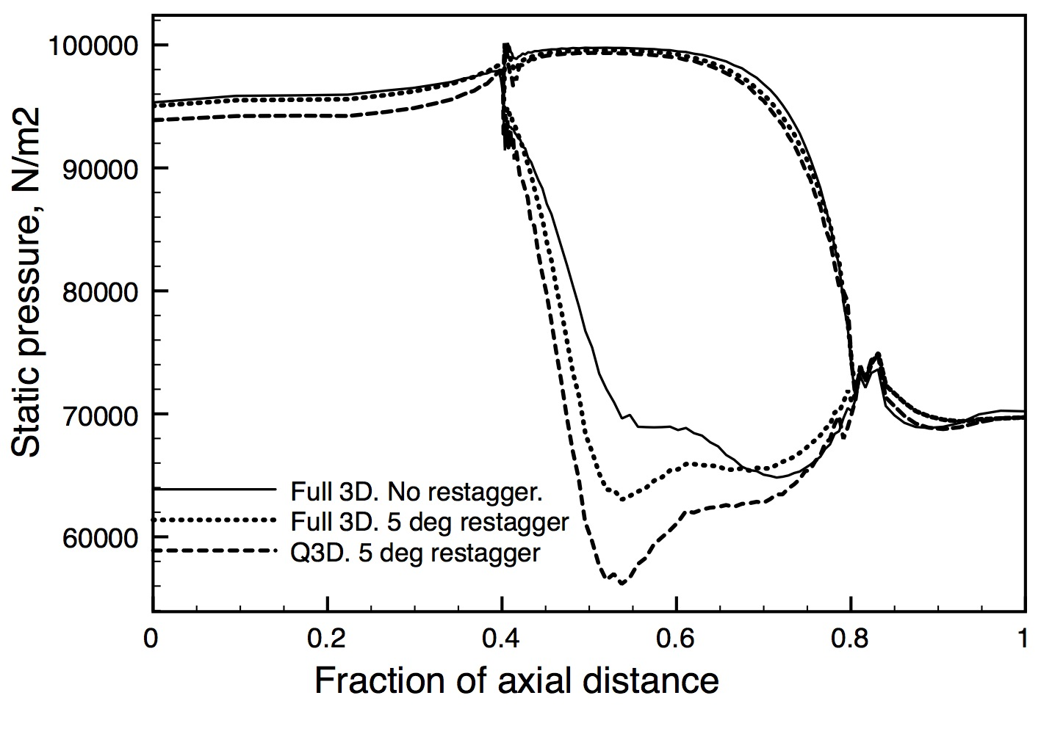
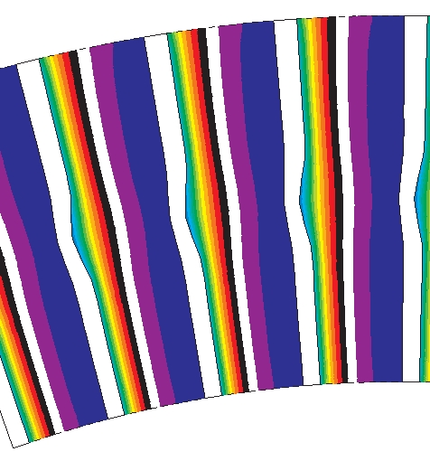
The quasi-3D calculations are anyhow not accurate unless twisted stream surfaces are used, as in Wu’s original suggestion.
This is virtually never done !
The figure below shows the results of a Q3D and a 3D calculation on a LP turbine blade where the mid-span section has been re-staggered by 5 deg.
Static pressure contours on the blade with re-stagger, showing 3D relief.
The Q3D calculation predicts the effect on loading to be about twice that of the 3D calculation.

Slide 6
THE SYSTEM CONSISTS OF 3 LINKED PROGRAMS
ALL WRITTEN IN FORTRAN
MEANGEN
Performs a 1D calculation to obtain the velocity triangles.
Sets the annulus boundaries. Generates initial blade shapes and twists them for a free vortex design.
Writes an input file for STAGEN
STAGEN
Refines the blade shapes. Stacks them and combines them into stages.
Writes an input file for MULTALL
MULTALL
Performs a 3D multistage calculation to predict the detailed flow pattern and overall performance.

Slide 7
MEANGEN
Takes input data either from the screen or from a file.
The input is designed to be as minimal as possible so many parameters are set by default. These can be changed by editing the program.
On the screen answer questions such as:
Design a compressor or a turbine? Answer ‘C’ or ‘T’.
Input the gas constant and specific heat ratio
Input the desired mass flow rate.
Input the rotational speed.
etc.
The screen input data is mirrored to a file and subsequent small changes to the design are most easily made by editing that file.
The initial design can be run through STAGEN and MULTALL without any further changes if required, but it will usually need to be refined by STAGEN.

Slide 8
MEANGEN generates data for complete stages. Single blade rows can be generated by omitting the output for one of the blade rows.
The blading parameters can defined either:
On a fixed radius and assuming repeating stage conditions. In which case only 3 parameters are needed to fix the velocity triangles. This makes it very easy to generate multiple repeating stages.
Or
On an arbitrary stream surface with changes in radius and meridional velocity. In which case 4 parameters are needed to fix the velocity triangles, which can differ from stage to stage.
The design stream surface can be either the hub, mid-span or tip. The variation of the blade angles along the span is obtained by assuming free vortex flow.

Slide 9
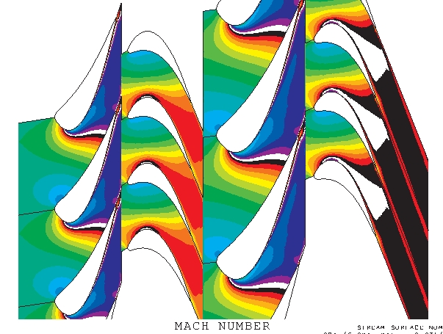
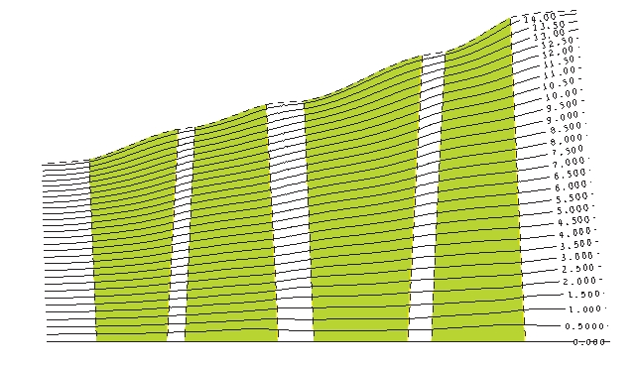
T TURBO_TYP,"C" FOR A COMPRESSOR,"T" FOR A TURBINE AXI FLO_TYP FOR AXIAL OR MIXED FLOW MACHINE 287.150 1.400 GAS PROPERTOES, RGAS, GAMMA 1.000 300.000 POIN, TOIN 2 NUMBER OF STAGES IN THE MACHINE H CHOICE OF DESIGN POINT RADIUS, HUB, MID or TIP 3000.000 ROTATION SPEED, RPM 15.000 MASS FLOW RATE, FLOWIN. A INTYPE, TO CHOOSE THE METHOD OF DEFINING THE VELOCITY TRIANGLES 0.200 0.500 2.000 REACTION, FLOW COEFF., LOADING COEFF. A RADTYPE, TO CHOOSE THE DESIGN POINT RADIUS 0.400 THE DESIGN POINT RADIUS 0.030 0.040 BLADE AXIAL CHORDS IN METRES. 0.250 0.500 ROW GAP AND STAGE GAP 0.900 GUESS OF THE STAGE ISENTROPIC EFFICIENCY 1.000 1.000 ESTIMATE OF THE DEVIATION ANGLES -2.000 -2.000 FIRST AND SECOND ROW INCIDENCE ANGLES 92.000 87.000 QO ANGLES AT LE AND TE OF ROW 1 87.000 93.000 QO ANGLES AT LE AND TE OF ROW 2 n DO YOU WANT TO CHANGE THE ANGLES FOR THIS STAGE, ANSWER "Y" or "N" y IFSAME_ALL, SET = "Y" TO REPEAT THE LAST STAGE VELOCITY TRIANGLES n DO YOU WANT TO CHANGE THE ANGLES FOR THIS STAGE, ANSWER "Y" or "N" Y IS OUTPUT REQUESTED FOR ALL BLADE ROWS ? n STATOR No. 1 SET ANSTK = "Y" TO USE THE SAME BLADE SECTIONS AS THE LAST STAGE 0.350 0.500 MAX THICKNESS AND ITS LOCATION FOR STATOR 1 SECTION No. 1 0.350 0.475 MAX THICKNESS AND ITS LOCATION FOR STATOR 1 SECTION No. 2 0.350 0.450 MAX THICKNESS AND ITS LOCATION FOR STATOR 1 SECTION No. 3 n ROTOR No. 1 SET ANSTK = "Y" TO USE THE SAME BLADE SECTIONS AS THE LAST STAGE 0.300 0.400 MAX THICKNESS AND ITS LOCATION FOR ROTOR 1 SECTION No. 1 0.250 0.400 MAX THICKNESS AND ITS LOCATION FOR ROTOR 1 SECTION No. 2 0.200 0.400 MAX THICKNESS AND ITS LOCATION FOR ROTOR 1 SECTION No. 3 y STATOR No. 2 SET ANSTK= "Y" TO CHOOSE THE SAME BLADE SECTIONS AS THE LAST STAGE. y ROTOR No. 2 SET ANSTK= "Y" TO CHOOSE THE SAME BLADE SECTIONS AS THE LAST STAGE.
This file, produced by answering questions on the screen.
(Only the numbers and characters on the left are input)
Produces this Turbine

Slide 10
STAGEN
Reads in a data file produced by MEANGEN.
Allows the blade sections to be changed from the initial crude guess.
Projects the blades onto quasi-stream surfaces.
Stacks the blades.
Generates the grid.
Combines the blades into stages.
Writes an input data file for MULTALL .
As with MEANGEN many parameters are set by default and can be changed by editing the program.
The blade profiles may be either:
Generated from a system of equations.
Generated from an input camber line and thickness distribution.
Read in from an existing profile.

Slide 11
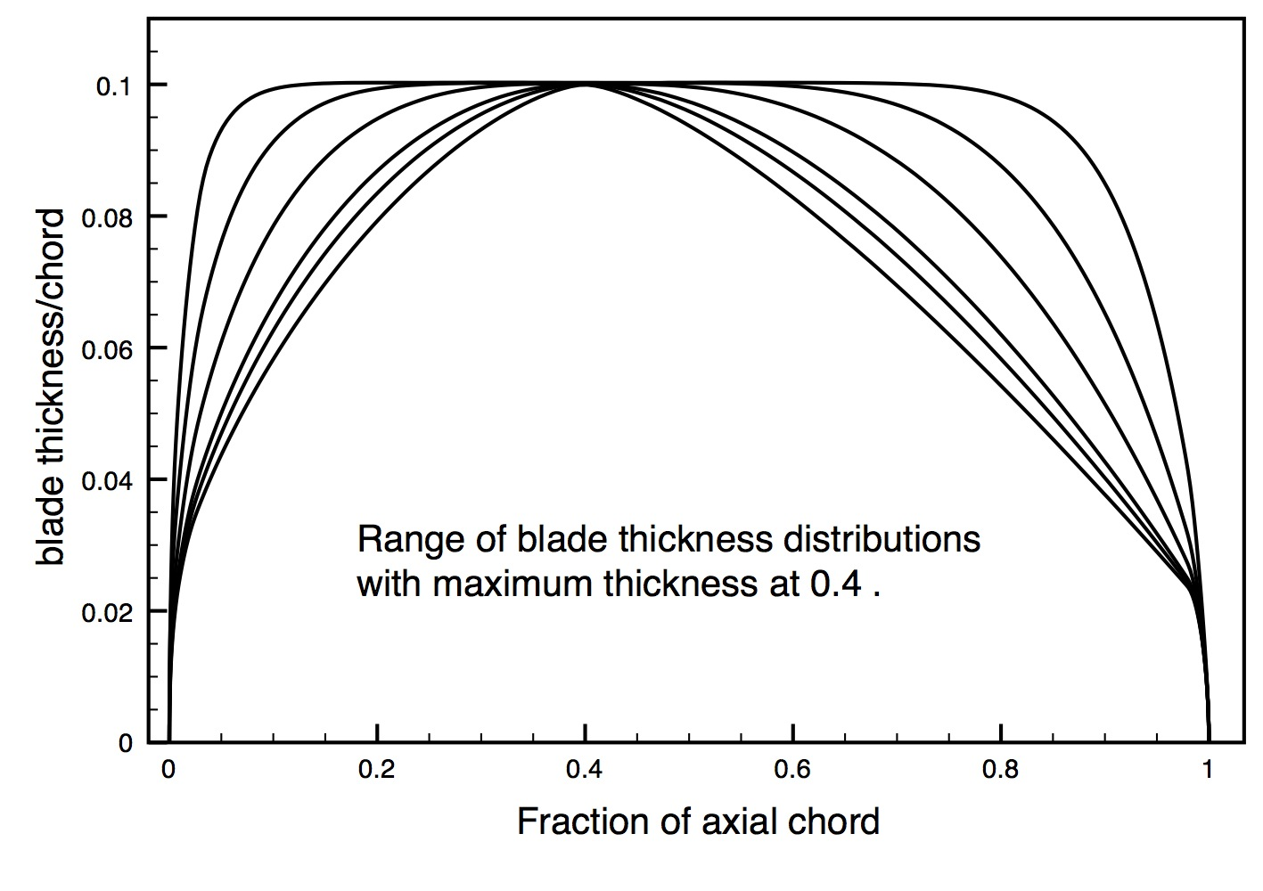
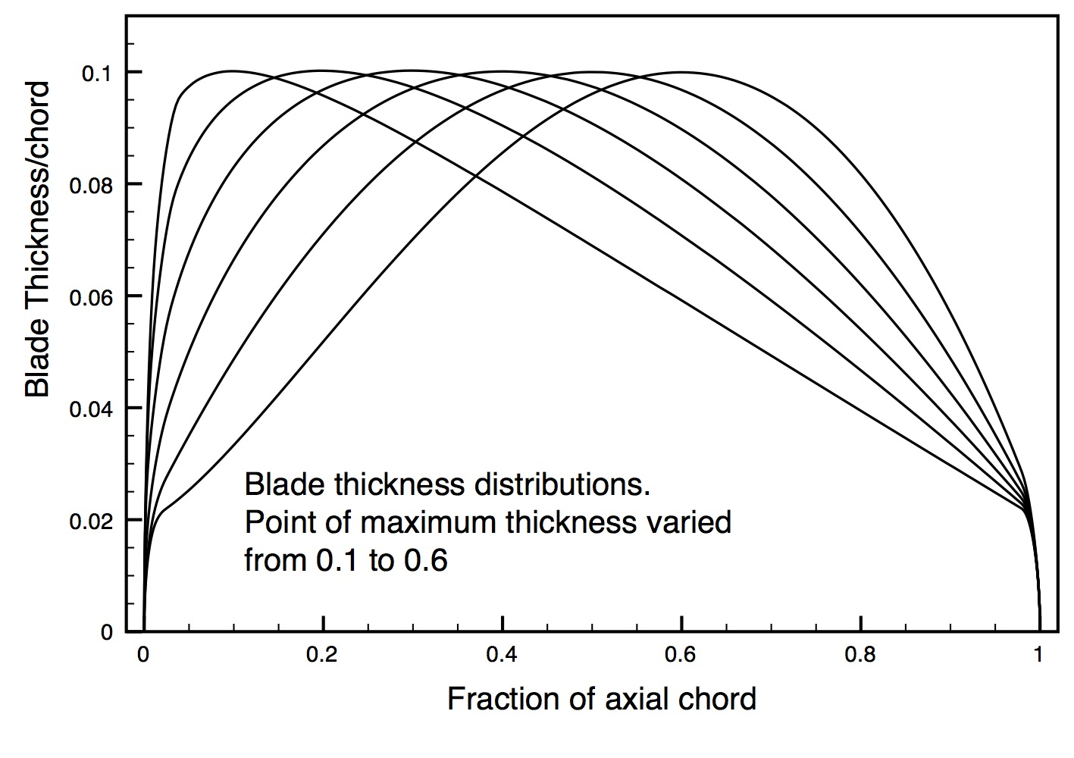
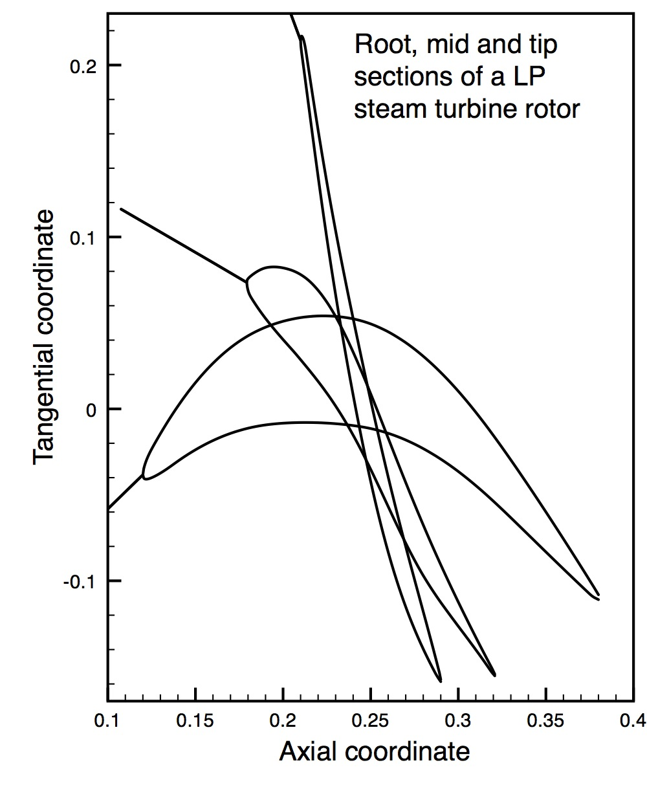
Blade thickness distributions from equations.
Root, mid and tip blade sections generated for an LP steam turbine last rotor.

Slide 12
MULTALL
3D multistage N-S solver developed over many years. Using on a finite volume time-marching method.
It can model most turbomachinery flow features, including:
Mixing plane model between blade rows.
Quasi-3D blade-to-blade calculations.
Axisymmetric throughflow calculations.
Three turbulence models.
Specified boundary layer transition point, or a simple transition model.
Surface roughness effects.
Cooling flow addition through the blades or endwalls.
Bleed flows from the hub or casing.
Artificial compressibility for low Mach number and incompressible flows.
Pinched tip model for plain tip clearances.
Shroud leakage model for shrouded blades.
Temperature dependent gas properties.
Automatic matching of the grids at the mixing plane.
Ability to refine the grids within the code.
Automatic trailing edge cusp generation.
Modification of the inlet boundary conditions to simulate a repeating stage.
Ability to perform limited blade redesign within the 3D code.
Most of these are briefly described in the paper, and in detail in the user manual, but there is no time to describe them here.

Slide 13
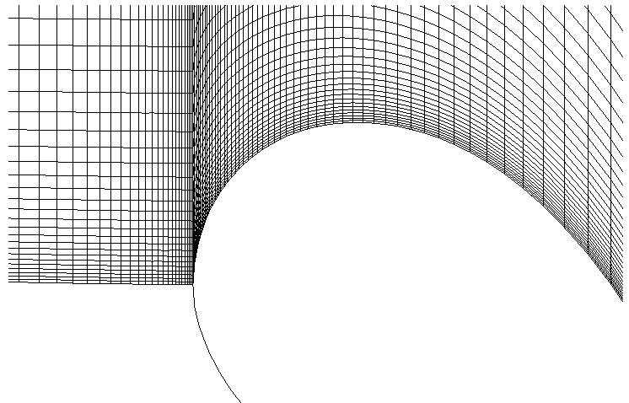
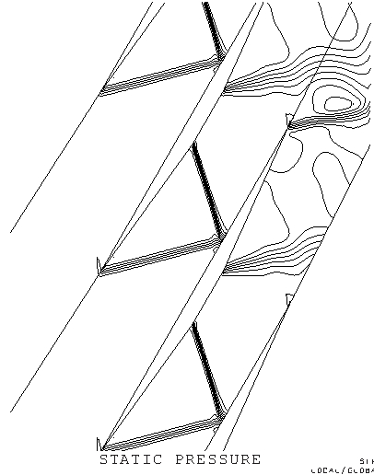
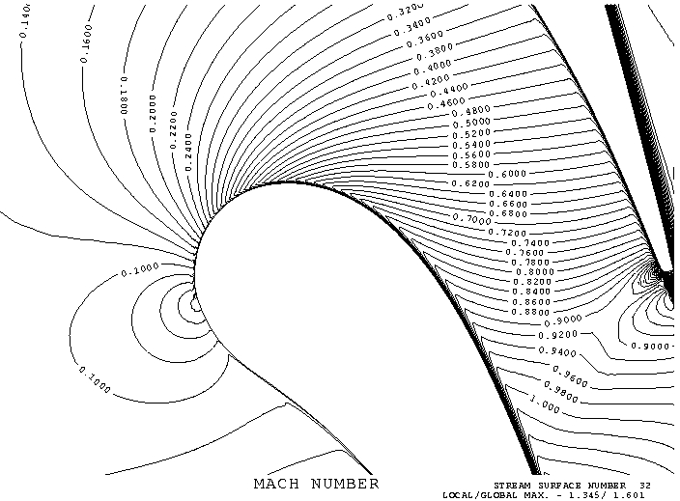
MULTALL uses a simple “H” grid, which is extremely simple to generate and is anyhow always necessary at mixing planes. However, use of an “H” mesh is much disapproved of by CFD specialists because of numerical errors on highly sheared cells.
However, using cell corner storage of the variables, MULTALL works remarkably well on sheared grids, its speed and simplicity allow more cells to be used in highly sheared regions.
Comparison with the exact solution on a 60deg staggered wedge.
Inlet Mach number =1.6.
Turbine leading edge stagnation point

Slide 14
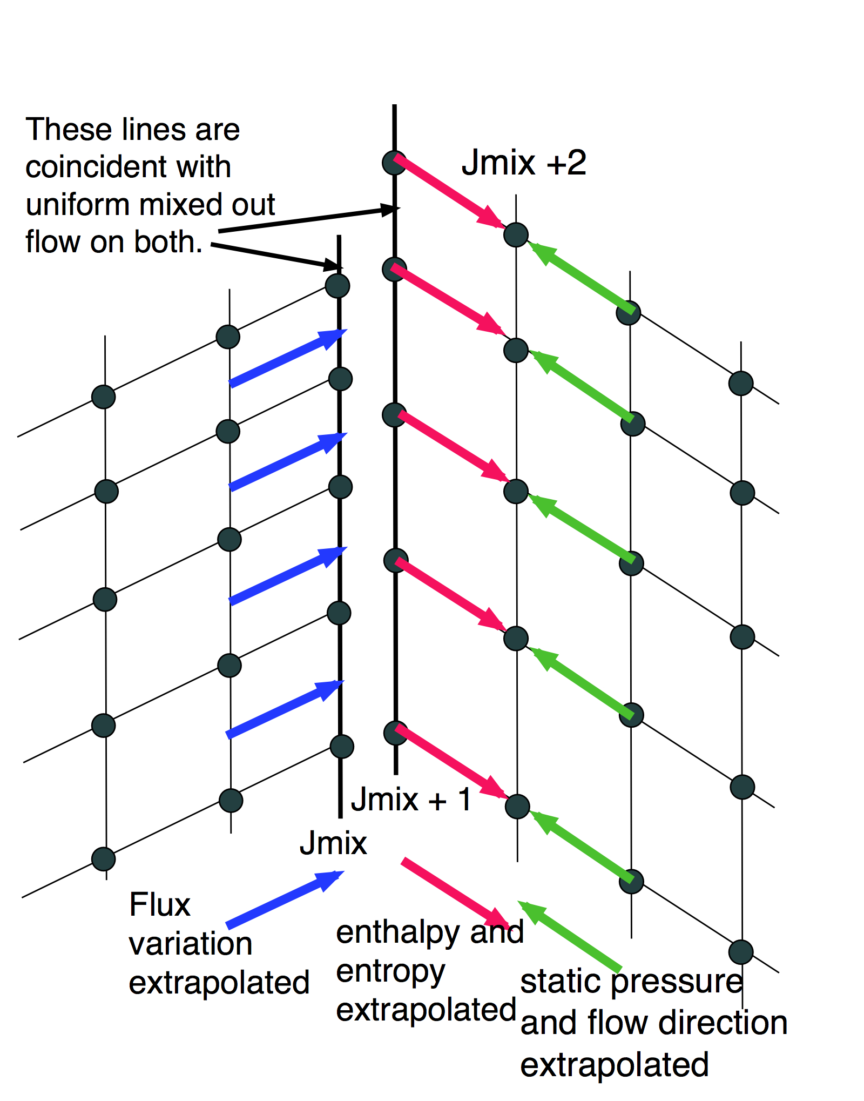
MULTALL uses mixing planes between blade rows in relative motion.
The mixing plane model has been refined over many years. There are two coincident pitchwise grid lines at the mixing plane. The flow quantities are extrapolated onto these lines and the flow between them is matched by a 1D time-marching procedure.

Slide 15
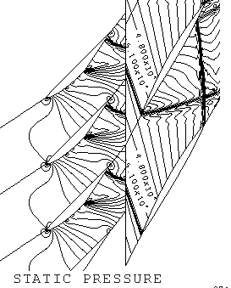
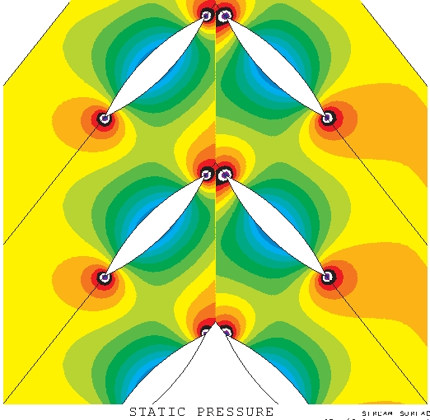
The mixing plane should allow pressure waves to intersect it without reflection and should mix out a potential flow without any loss. The flow downstream of it should have pitchwise uniform entropy and relative stagnation enthalpy.

Slide 16
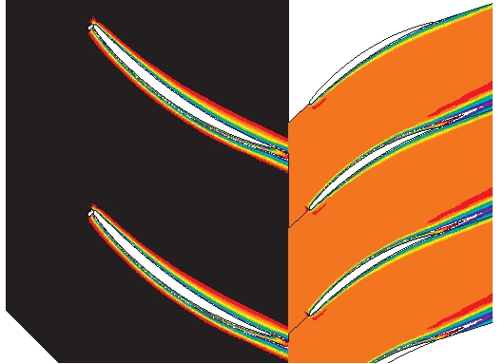
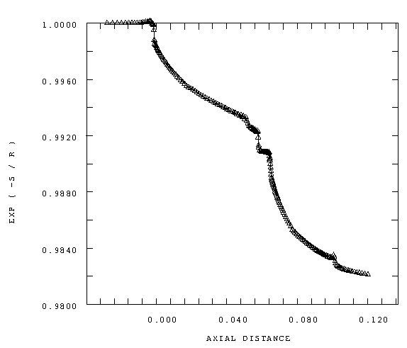
Entropy contours, the entropy is pitchwise uniform immediately downstream of the mixing plane.
Entropy changes at a mixing plane.
The mass averaged entropy increases at the mixing plane as required for the mixing loss.
Mass averaged entropy function
Axial distance

Slide 17
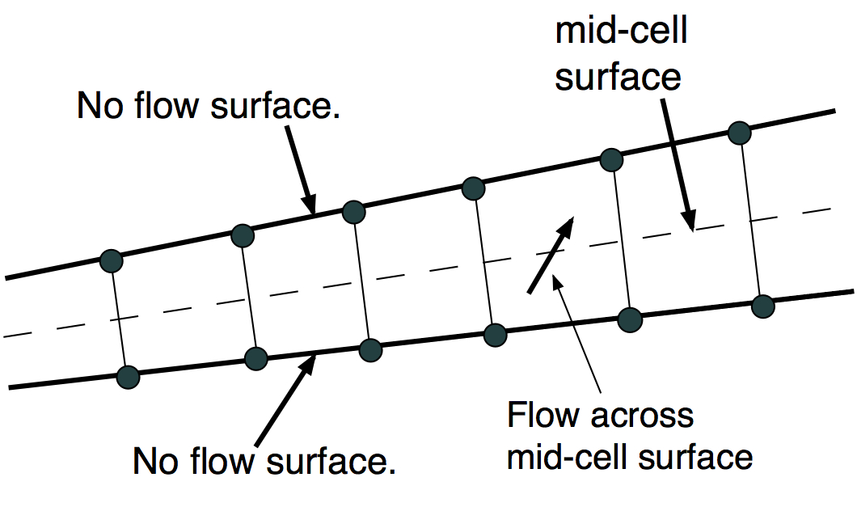
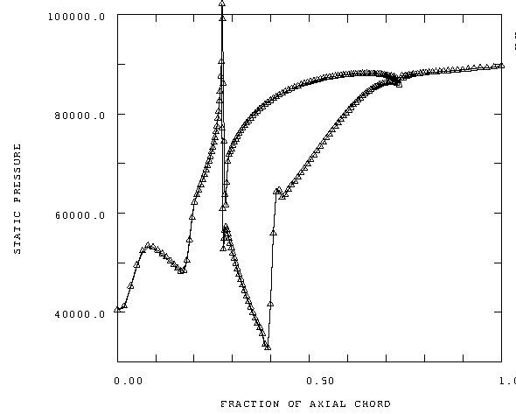
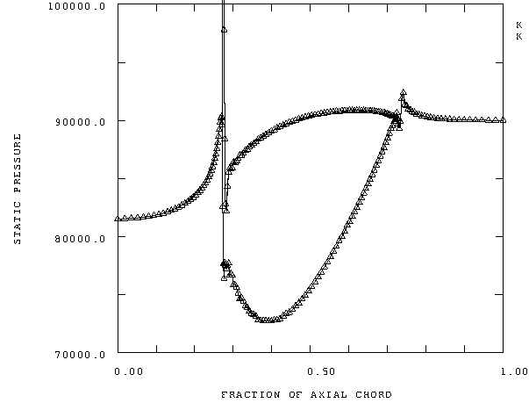
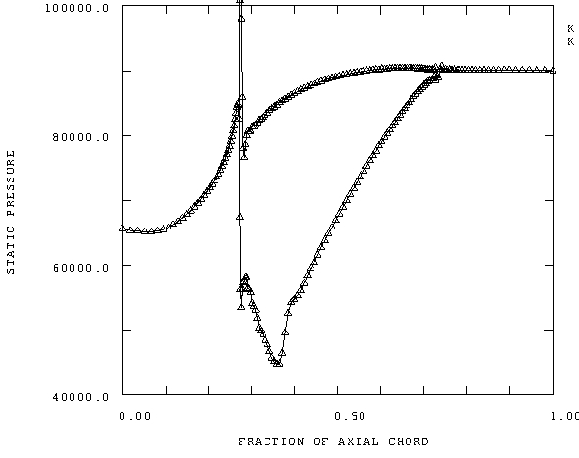
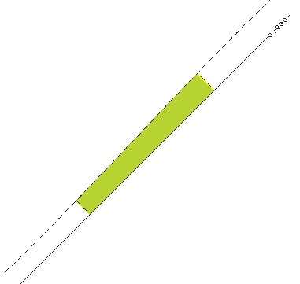
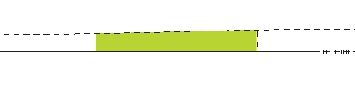
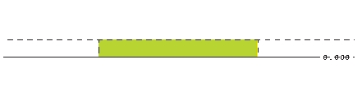
MULTALL can be run as a quasi-3D blade-to-blade solver by setting a single cell in the spanwise direction.
Any flow across the imaginary mid-cell line generates a pressure difference between the two end walls which keeps the flow on the stream surface.
Run times are of order 5-10 seconds per blade row.
45deg flare + 20% radius change.
2D cascade. Constant stream surface thickness.
Constant radius + 25% SS divergence.
Same compressor blade row with different stream surfaces

Slide 18
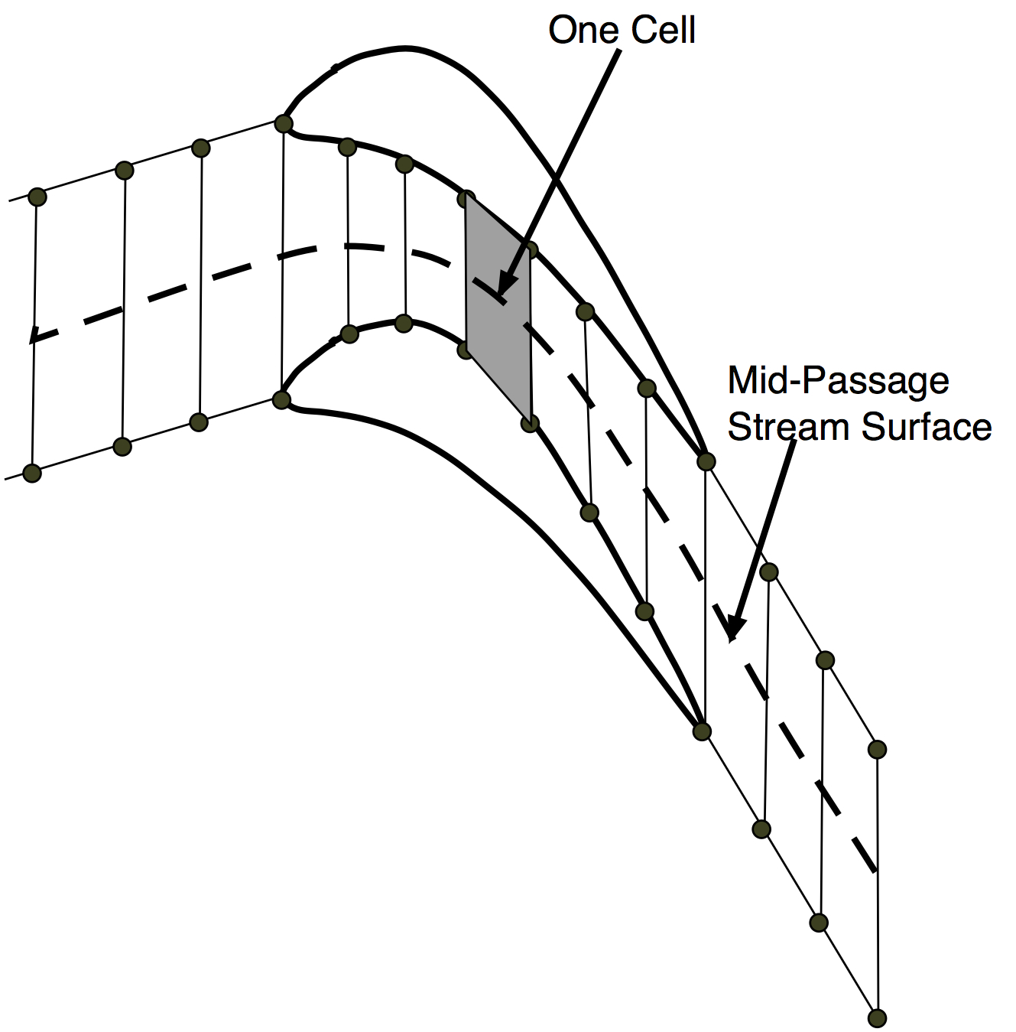
THROUGHFLOW CALCULATIONS
The code can be run as an axisymmetric throughflow calculation by setting a single cell in the pitchwise direction.
The full 3D geometry is input but far fewer grid points can be used.
As with the B-to-B method, any flow crossing the imaginary mid-passage line is made to increase the pressure on one blade surface and decrease it on the other. This gradually builds up a blade loading which keeps the flow on the mid-passage line. Deviation and incidence to the mid-passage line are added.
Although the blade loading calculated in this way is only a rough approximation to the true loading its overall magnitude is compatible with the momentum change.

Slide 19
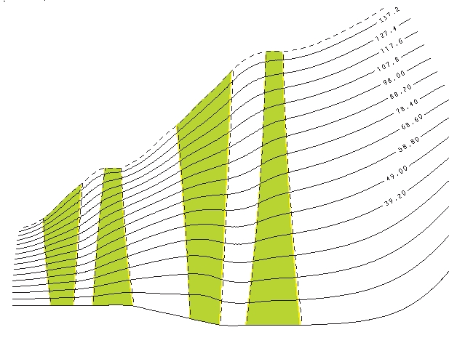
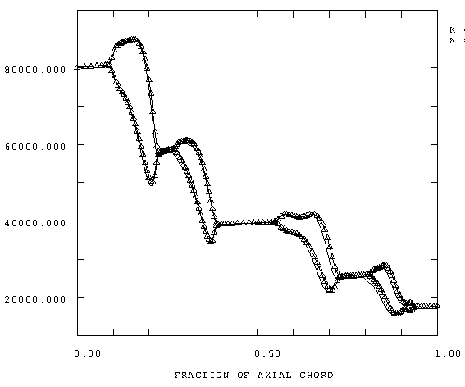
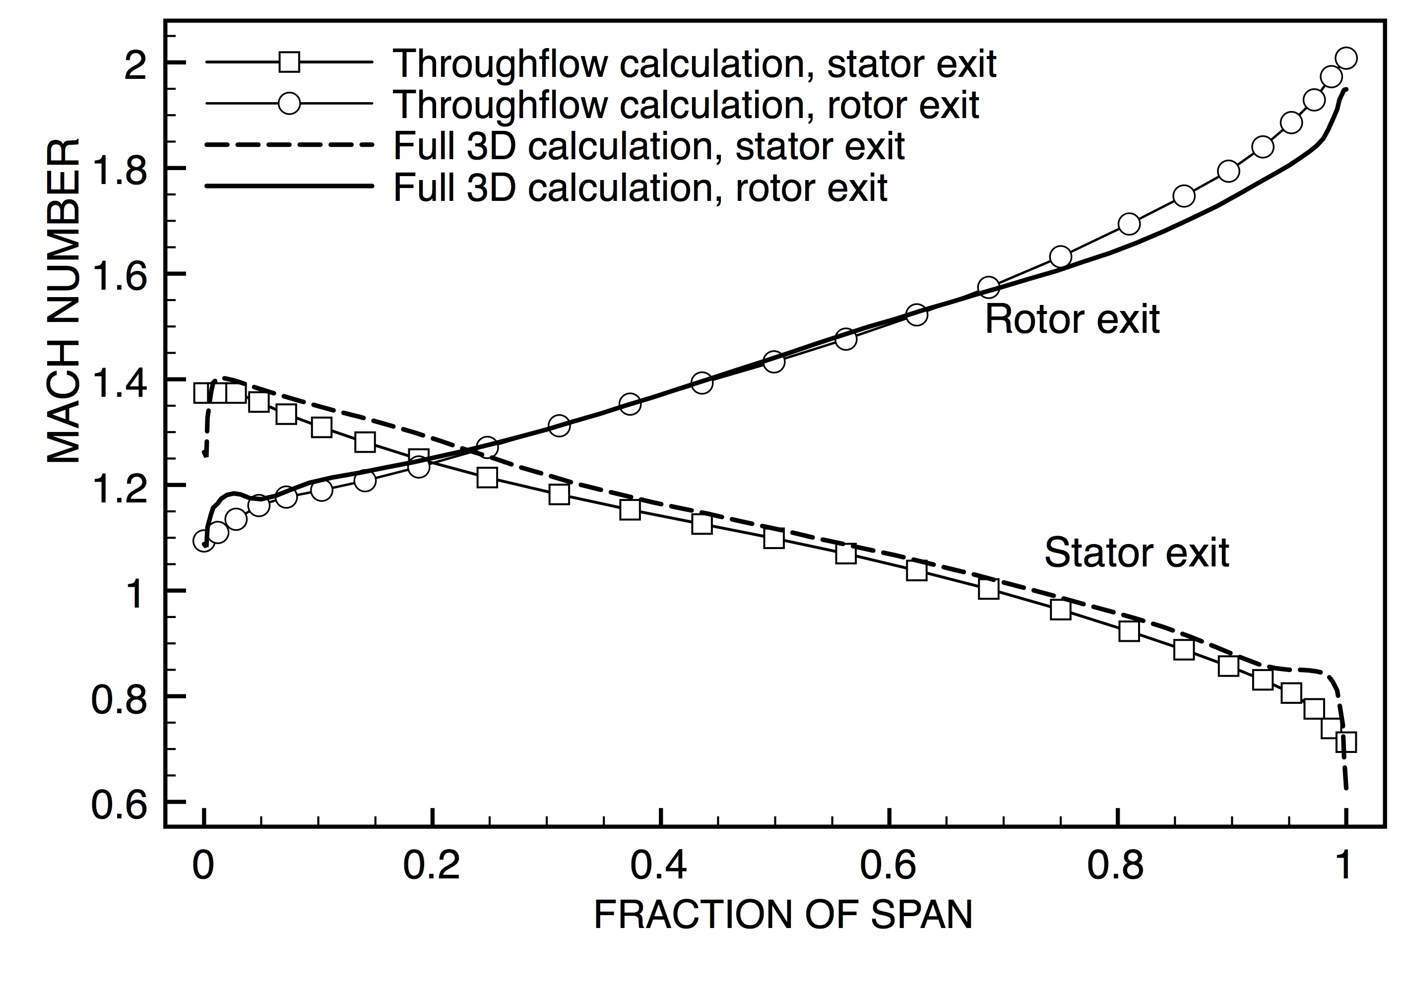
LP Steam turbine. Streamlines. Full 3D .
LP Steam turbine
Streamlines. Throughflow.
LP steam turbine, blade surface pressure distributions from throughflow.
Comparison of throughflow and full 3D Mach numbers in LP steam turbine.

Slide 20
The throughflow method works on a wide variety of machines.
Its advantages over conventional (streamline curvature) throughflow methods are:
It gives a crude estimate of blade loading.
It predicts the 3D effects of blade stacking.
The stability is not limited by the grid aspect ratio.
It predicts viscous losses on all solid surfaces via a very simple skin friction model.
It predicts tip leakage flows and losses.
It predicts the growth of endwall boundary layers, but not the associated secondary flows.
It works with a specified exit pressure rather than a specified mass flow.
It works with choked blade rows, including predicting supersonic deviation.
It predicts normal shock waves but not oblique shocks.
It is very easy to change from throughflow to full 3D calculation – change 2 lines of data.
Its disadvantages are:
It does not work in the inverse (design) mode.
Run times are 5-10 seconds per blade row rather than a fraction of a second with streamline curvature.
It requires a blade shape, although this can initially be a simple guess.
It does not give realistic pressure distributions for transonic compressors, but nor does any throughflow method.
Users are not so familiar with the method.

Slide 21
EXAMPLE OF USE OF THE DESIGN SYSTEM
Specify a large axial compressor with:
Mass flow rate 50kg/s
Stagnation pressure ratio = 2.0
Rotational speed = 5000 rpm
Constant tip diameter = 1m
Ambient inlet conditions 1bar, 300K .
Assuming an isentropic efficiency = 90% , a 3 stage machine with a moderate stage loading coefficient = 0.36 should satisfy the requirement.
The inlet Mach number at the tip would be near sonic so to reduce this 15º of inlet swirl is chosen. This is gradually reduced so there is no swirl at exit.
Run MEANGEN with specified inlet and outlet absolute flow angles (different for each stage), flow coefficient = 0.6, loading coefficient = 0.35.
Design on the tip stream surface.
Initially use a fairly coarse grid, 37x105x37, points per blade row. No tip clearance or hub seal leakage.

Slide 22
For the initial runs make changes only in MEANGEN to get good flow on the design stream surface, no attempt to optimise the blade sections at other radii.
M Produce an initial layout by running Meangen with default parameters and screen input. The solution has slightly low mass flow and pressure ratio.
M Increase the guess of deviation angles to increase the pressure ratio. Increase the
blade thickness and blade numbers. Several runs to obtain flow and pressure ratio close to the specified values.
M The blades are mid-loaded. Move the point of maximum thickness and point of maximum camber forwards to obtain more fore-loaded blades. Reduce the trailing
edge thickness. Several runs to obtain the required mass flow and pressure ratio.
M Move the point of maximum camber slightly further forwards. The blades now have
good surface pressure distributions but there are high incidences on some sections.
Adjust the average incidence angles for each row. Several runs.
Total about 12 3D runs. Each run takes about 12 minutes on a single processor.

Slide 23
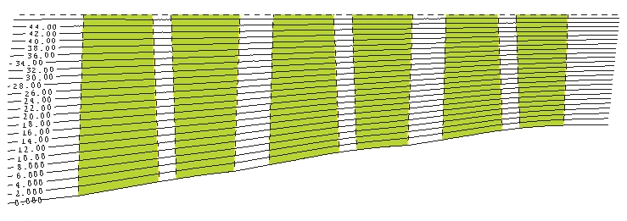
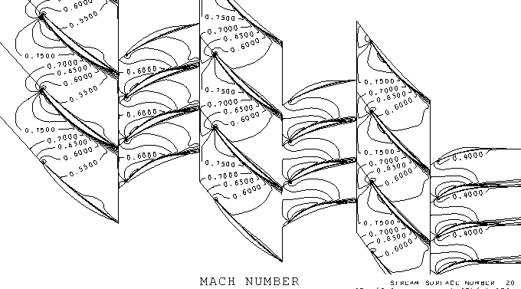
Results from the FIRST run using MEANGEN alone.
Meridional view with streamlines
Mid-span Mach numbers

Slide 24
Now make further changes by editing the STAGEN input file to refine the blade sections and adjust the incidences along the span
S Change to a finer 55x140x55 point grid with tip gaps on all rotors, 5 cells in each tip gap. Adjust the incidence angles along the span. Rotor 3 is most highly loaded
so increase its blade numbers. Several runs.
S Add hub shroud leakages on all stators. Adjust incidences. Several runs.
S Bow all stators, with pressure surfaces leaned towards the endwalls, to reduce endwall loadings. Re-adjust the incidences. The performance is now very close to specification with a predicted isentropic efficiency of 91.5% .
S To improve the stall margin add forwards sweep at all rotor tips by increasing the
chord by 15% with a fixed trailing edge location.
S Further refine the blade incidences. Several runs.
S Run a characteristic from choke to stall.
S Run a very fine grid solution, 83x299x83 points per row, at the design point to
check for any grid sensitivity. The mass flow and pressure ratio each changed
by about 0.1% and the efficiency was 0.4% lower.
Total about 17 3D runs, each taking about 30 minutes when starting from the previous solution.

Slide 25
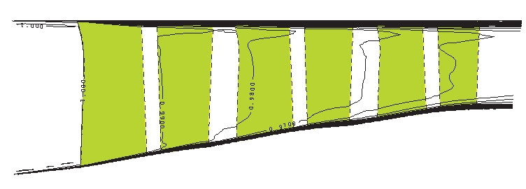
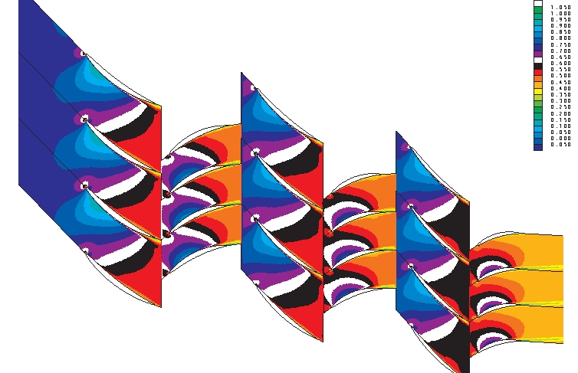
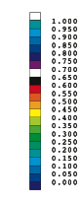
Details of the final design
Meridional view with entropy contours
Mid-span Mach numbers

Slide 26
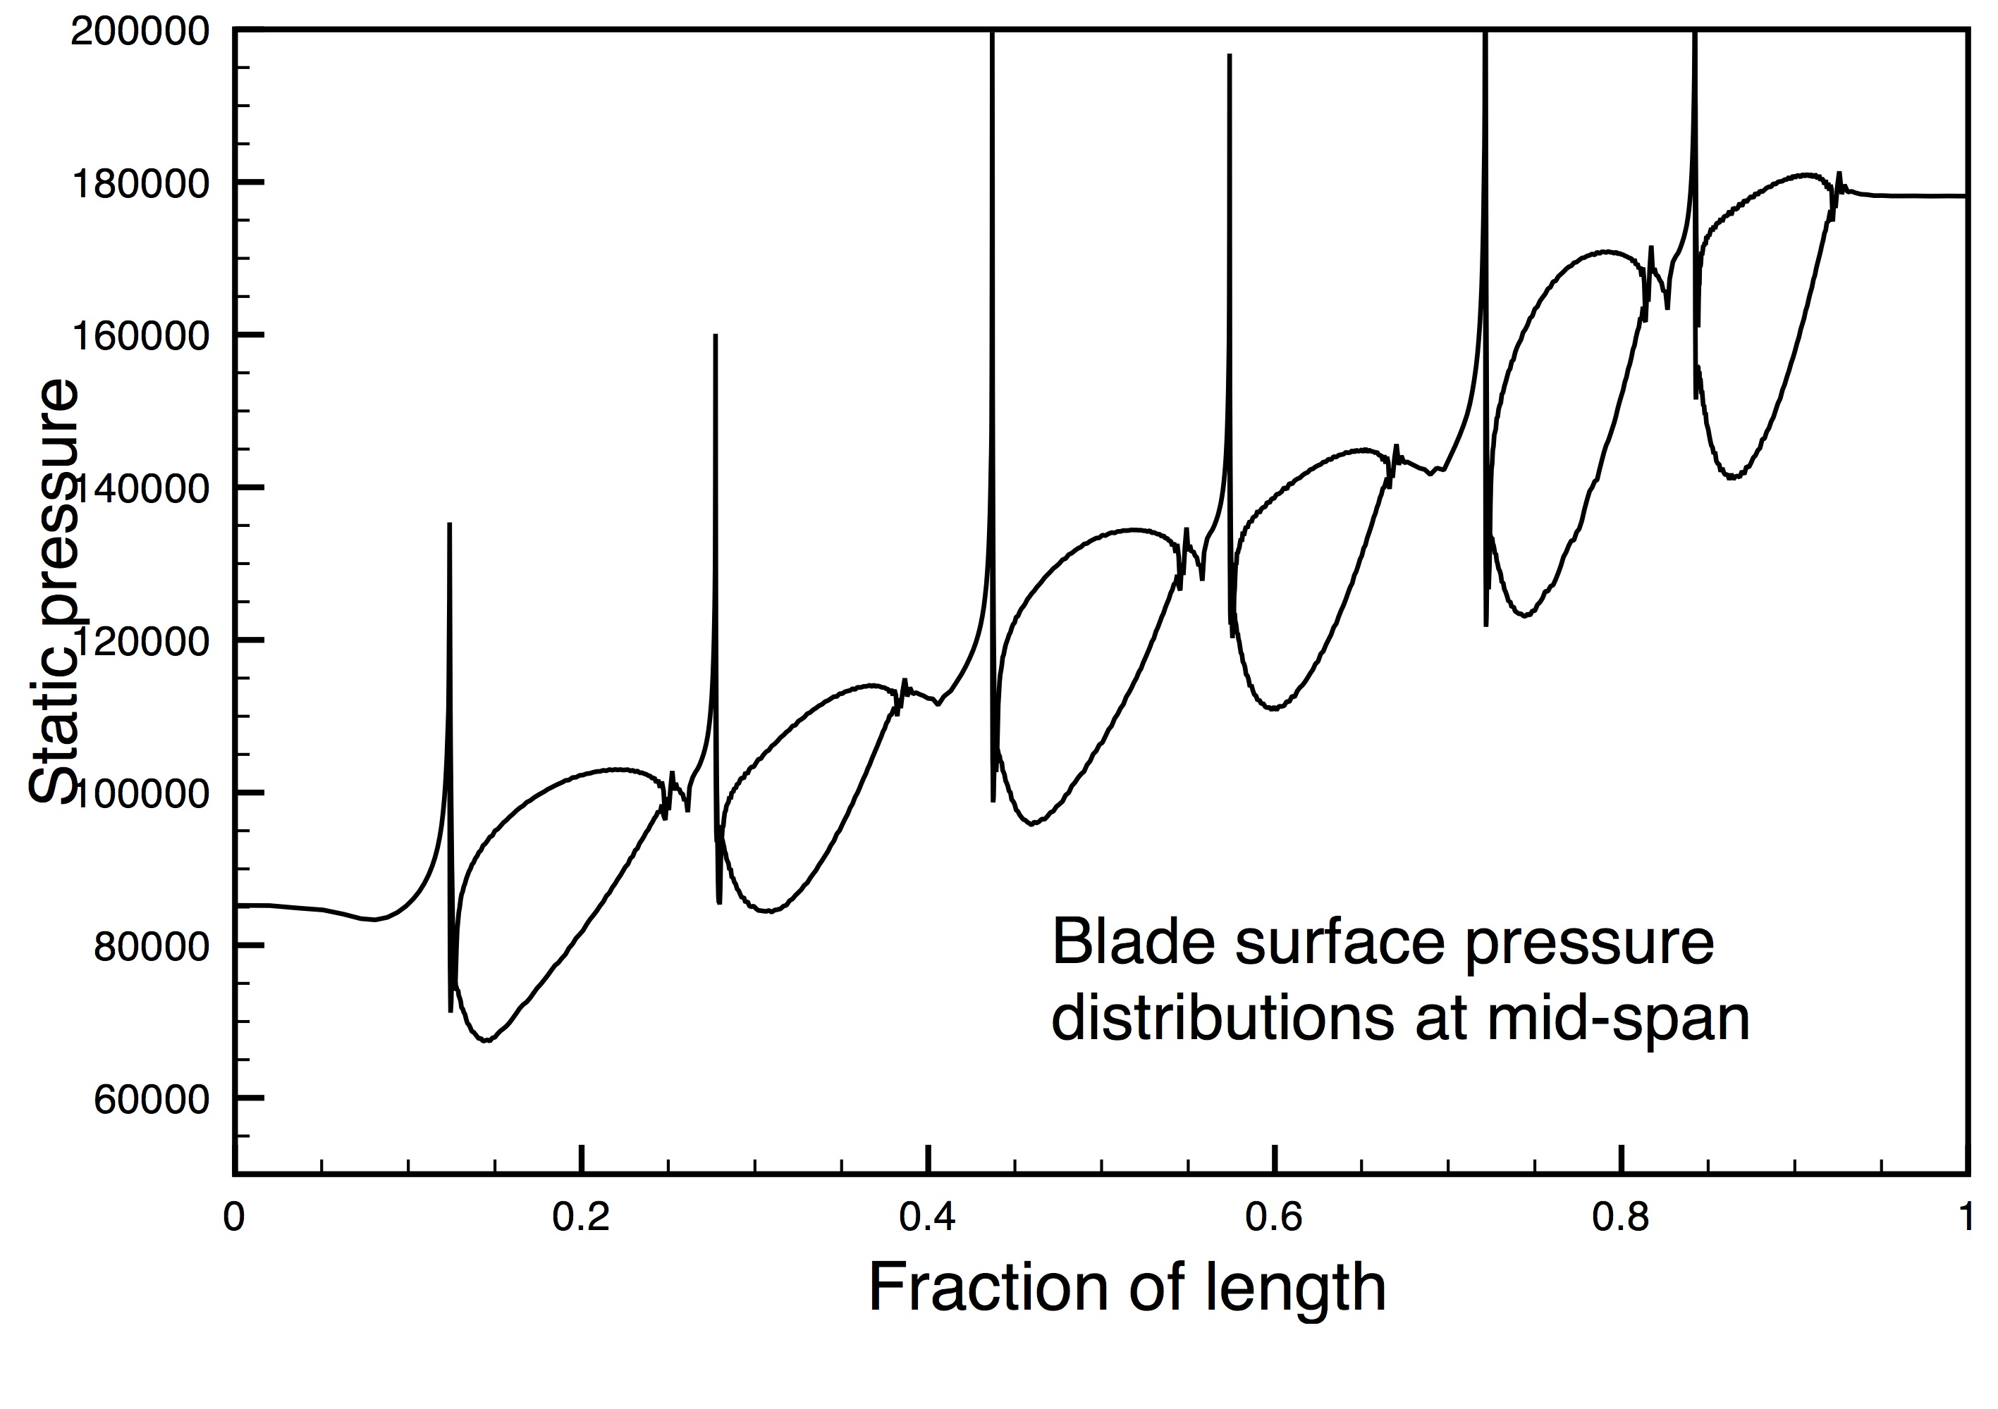
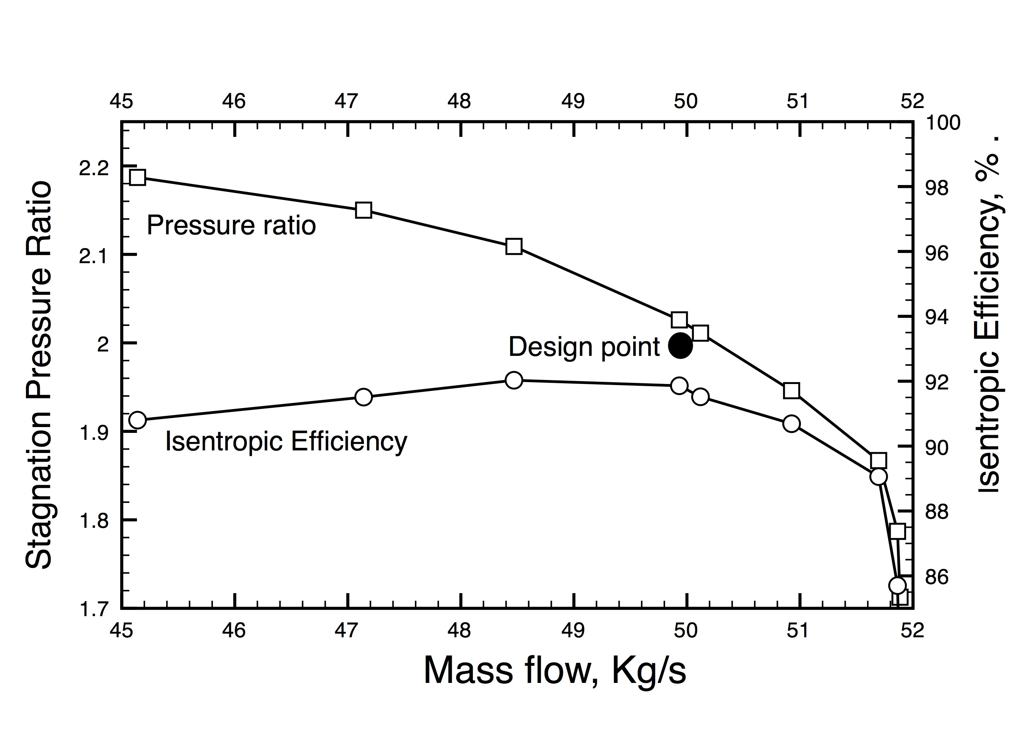
Uniformly loaded blades
Pressure ratio and efficiency slightly exceed the design targets

Slide 27
In total the design used about 30 3D runs, requiring about 12 hours CPU time on a single processor of a LINUX desktop (home) computer.
However, more time than this is necessary for “thinking” about what changes to make next.
Allowing for this, the design could be completed in about 3 person days.

Slide 28
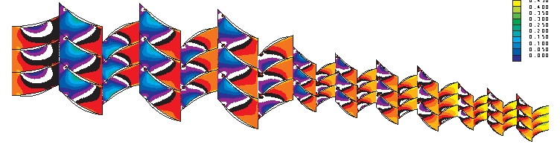
CONCLUSIONS
The design system is relatively simple, easy to use and fast to run.
However, as with any design process, it requires an experienced user to know what geometrical changes are needed to produce the required flow behaviour. Repeated use of the design system is a good way of acquiring such experience.
MULTALL is a useful tool in its own right. It is simpler and faster than most CFD codes and some of the techniques used in it may be of use to other CFD developers.

Slide 29
The FORTRAN source codes, user manuals and sample data sets can be downloaded as a folder named ‘multall-open’ from ‘dropbox’ using the following link.
https://www.dropbox.com/sh/8i0jyxzjb57q4j4/AABD9GQ1MUFwUm5hMWFylucva?dl=0
You do not need a ‘dropbox’ account to access this.
A brief description of the system and a copy of the link is also available on the web site
https://sites.google.com/view/multall-turbomachinery-design
Any future developments to the programs or changes to the link will be announced on this web site.

Slide 30
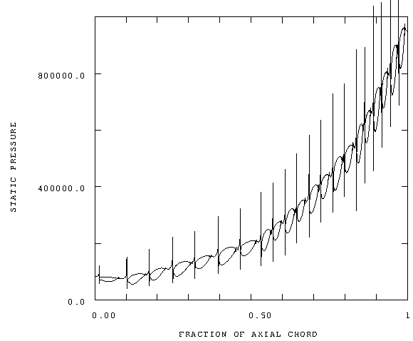
10 stage compressor with overall pressure ratio 10:1

Slide 31
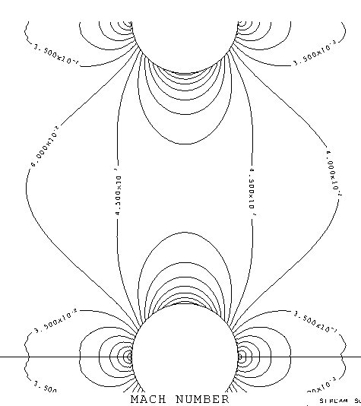
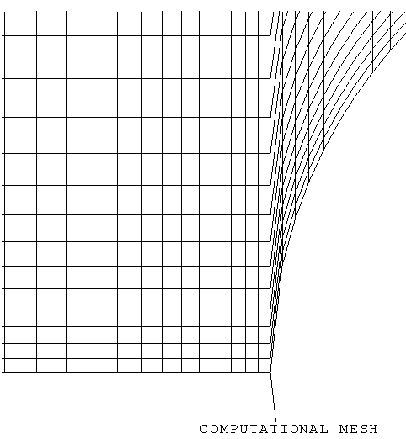
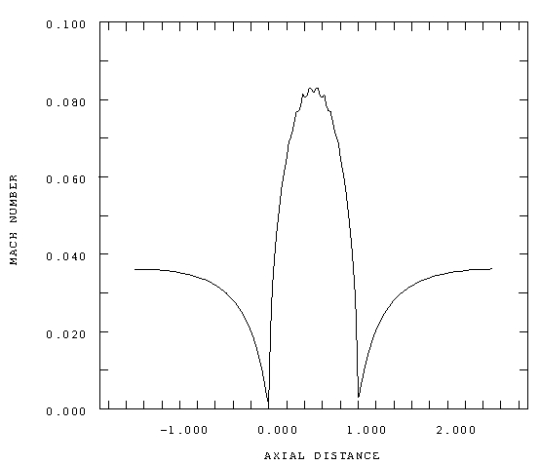
Low Mach number flow around a cascade of cylinders.
Maximum Mach number = 0.08.

Slide 32
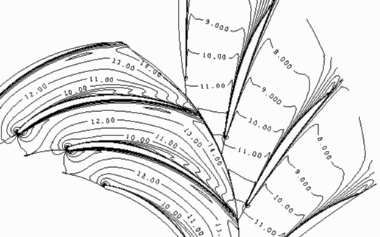
Flow in a water pump. Contours of relative velocity.

